Slide 1








Wake up it’s Time for Sleep
Become the European Sleep Expert of Tomorrow

Slide 2


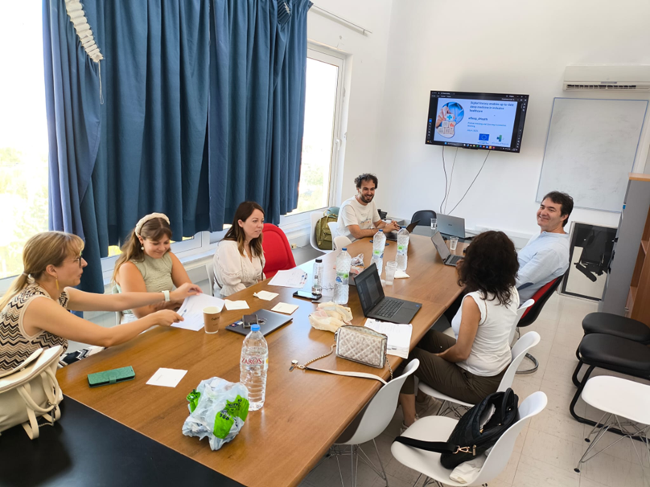

The eSleep_dHealth course is underway, with students actively participating. The course is actively running, engaging students from partner universities. Activities include lectures, teamwork, and innovation-focused assignments related to sleep apnea challenges.
eSleep_dHealth updates

Slide 3
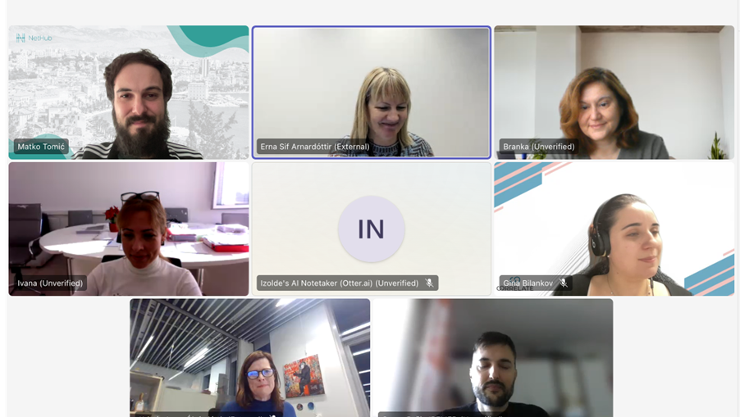
Regular Steering Committee meetings ensure smooth progress.
Discussions cover:
Monitoring course activities; Preparing upcoming events; Coordinating among partner universities
Steering Committee Meetings

Slide 4


July 3–7, 2025
First Learning Expedition
Greece
Upcoming project events
July 5, 2025
Third project conference
First learning expedition
(innovation sprint)
Greece

Slide 5
