Slide 1








Wake up it’s Time for Sleep
Become the European Sleep Expert of Tomorrow

Slide 2


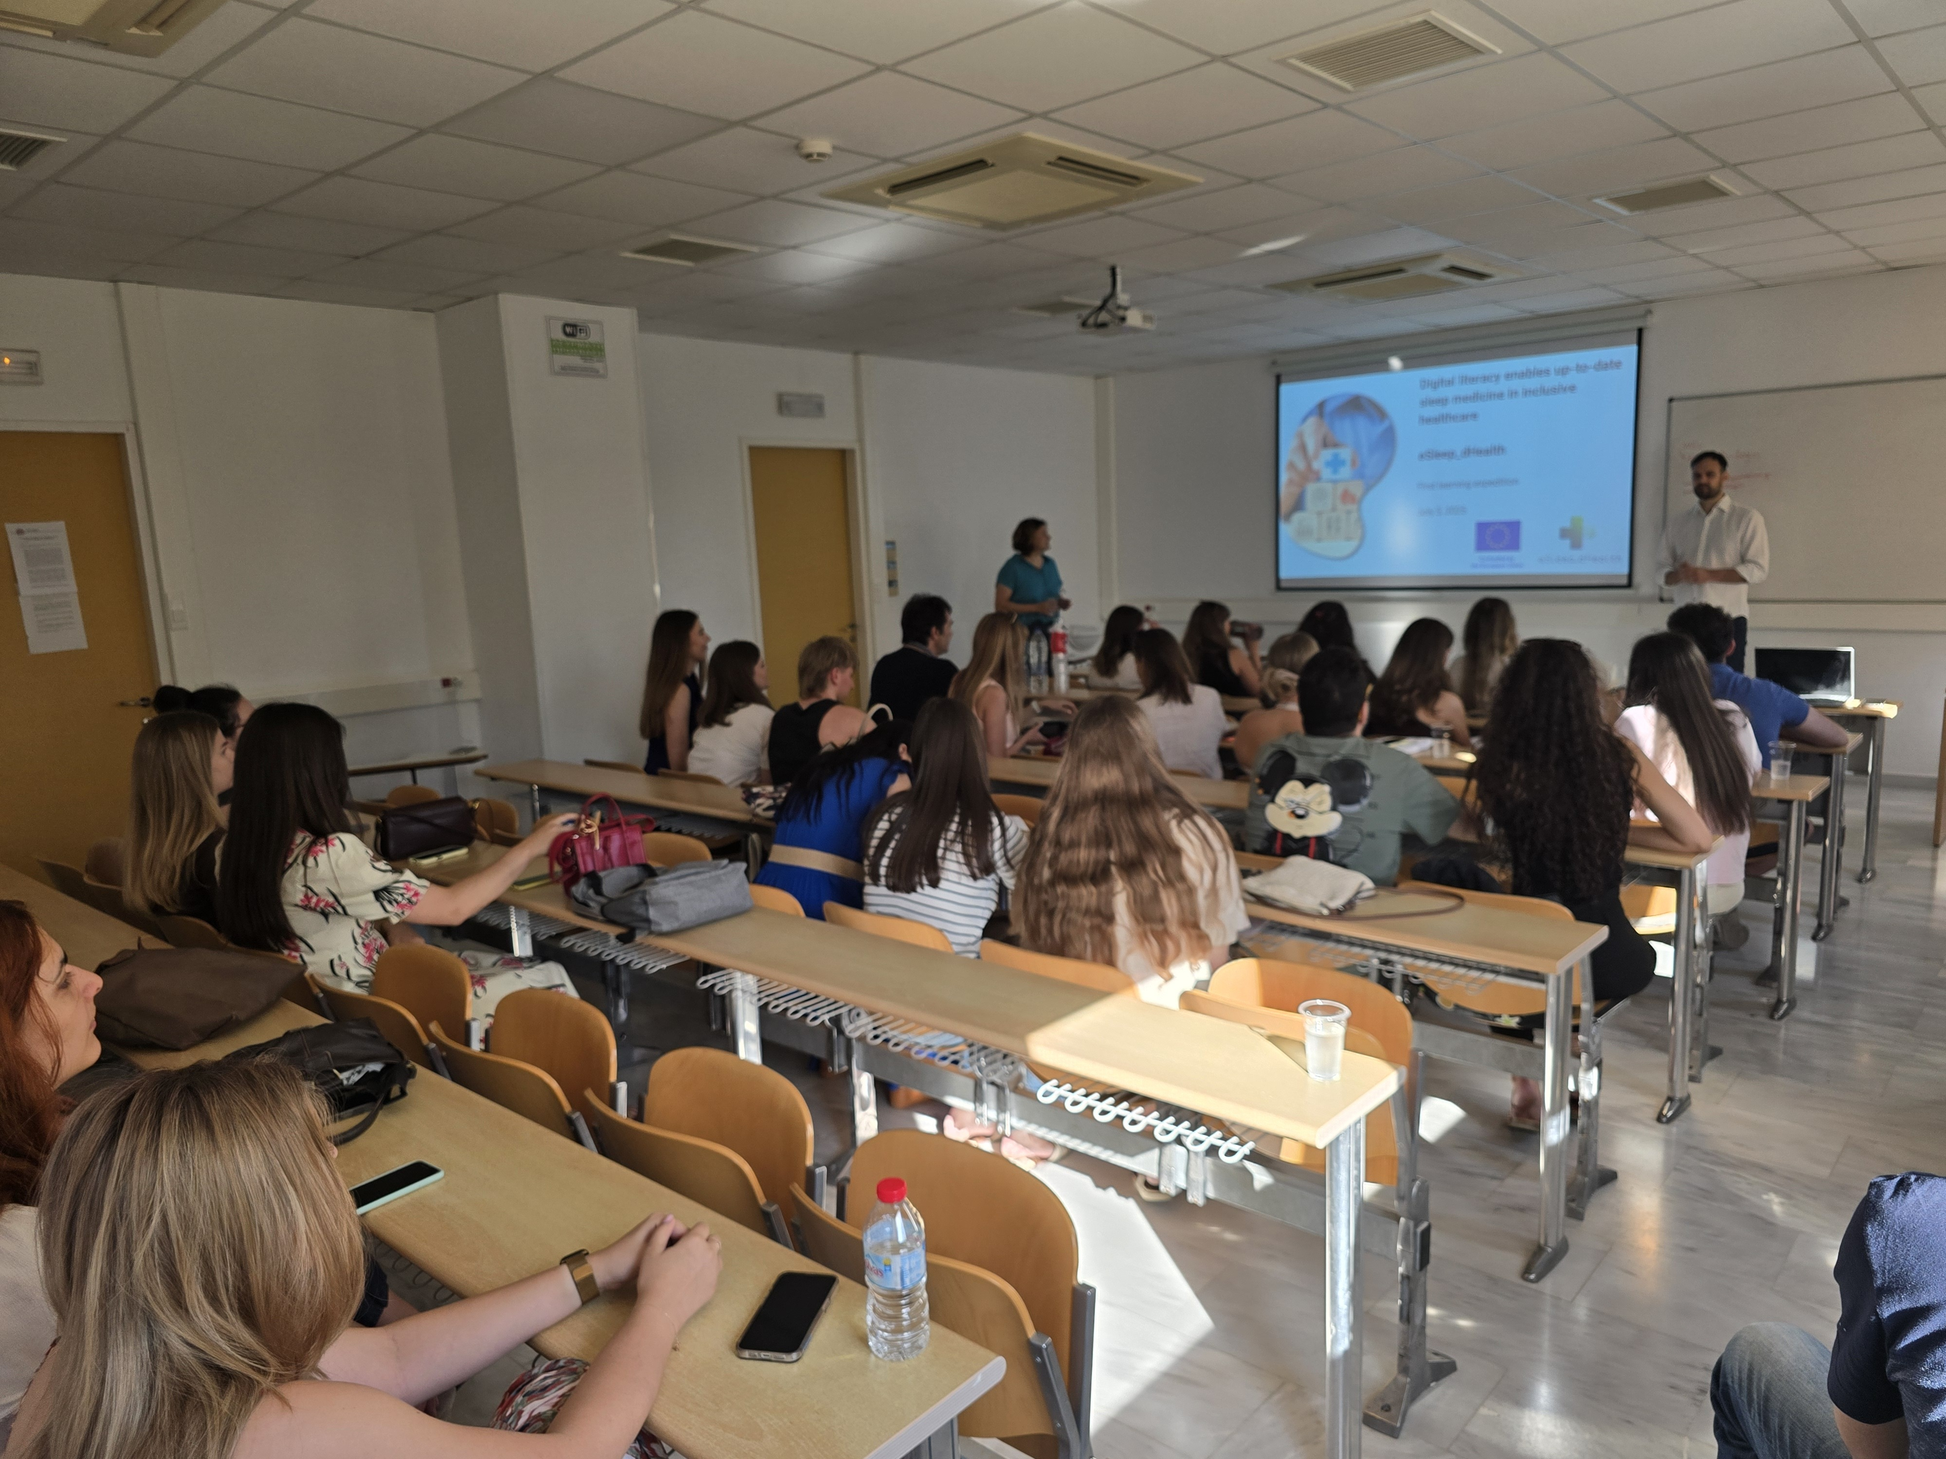

July 3–7, 2025, University of Crete, Heraklion
24 students from:
University of Split,
University of Crete
Reykjavik University
First Learning Expedition

Slide 3
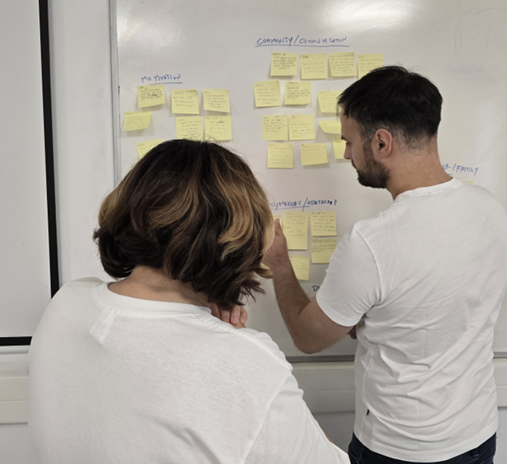
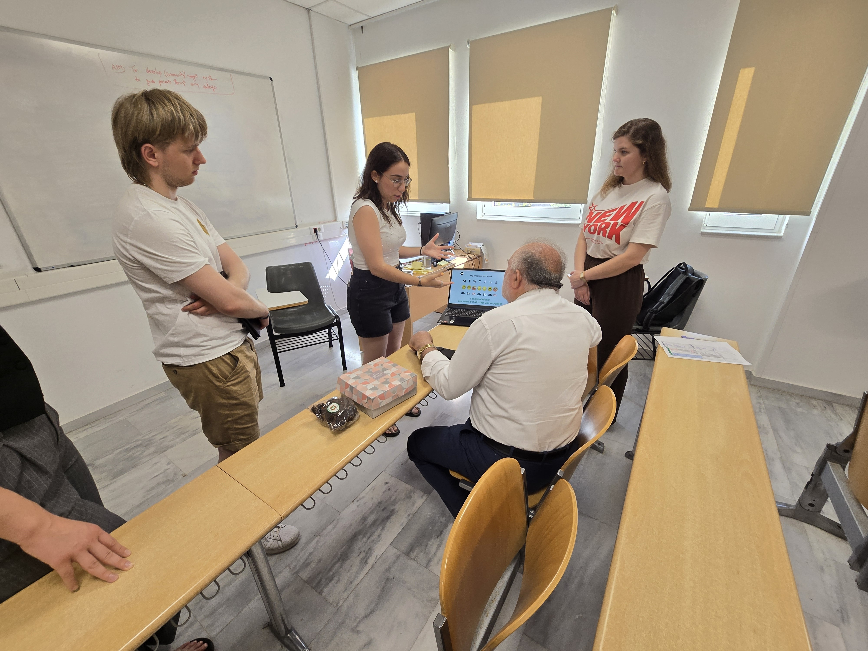
Students worked in international teams, applying design thinking to boost home compliance with CPAP therapy for sleep apnea patients.They conducted patient interviews, created problem statements, developed prototypes, and tested them with real users.
First Learning Expedition

Slide 4
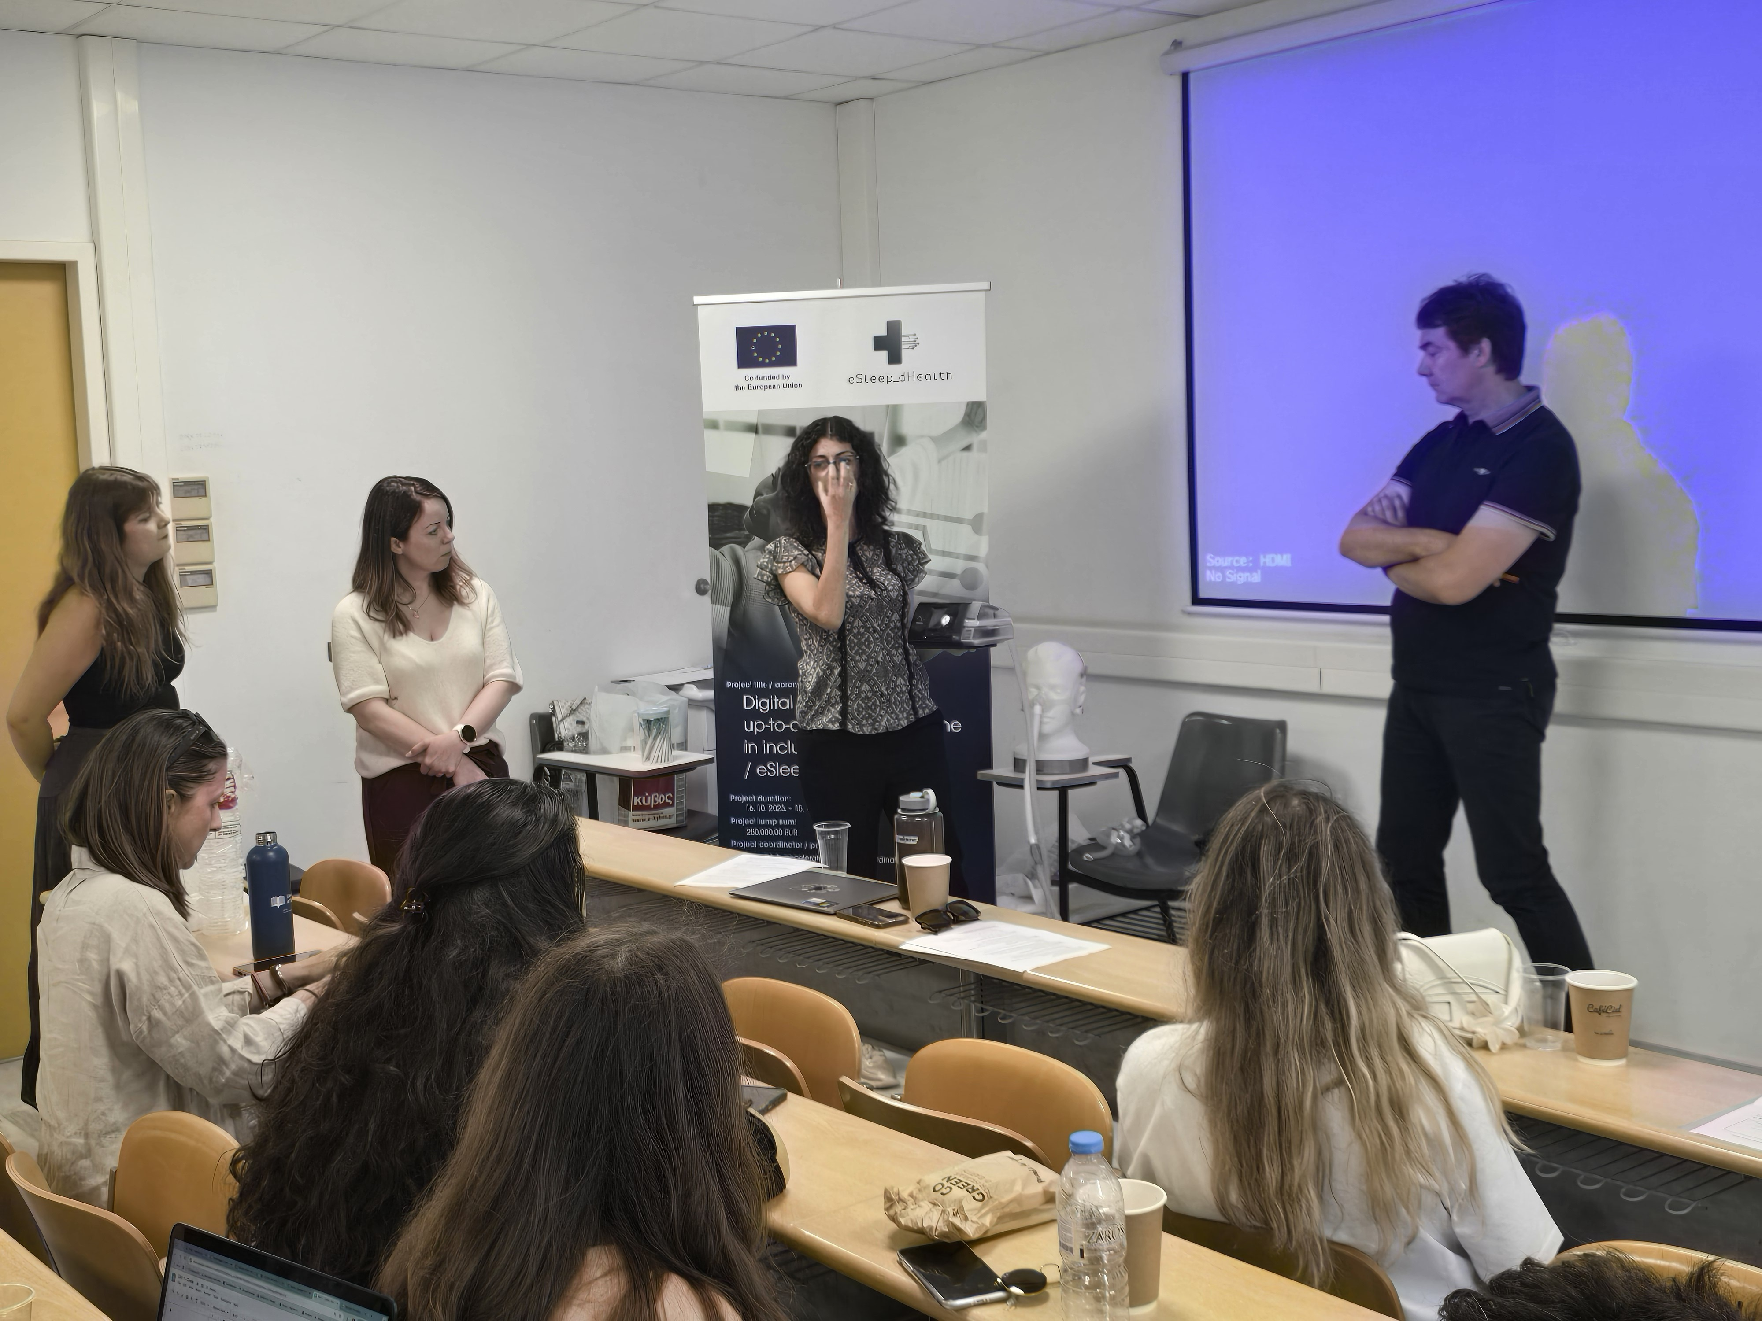
First Learning Expedition

Slide 5


From First Learning expedition till September Summer in Cloud incubation Focusing on raising awareness of sleep apnea through a digital solution
Upcoming project events
22. – 26. September 2025.
Second Learning Expedition Demo Day for selected projects - where a jury will select the winning project

Slide 6
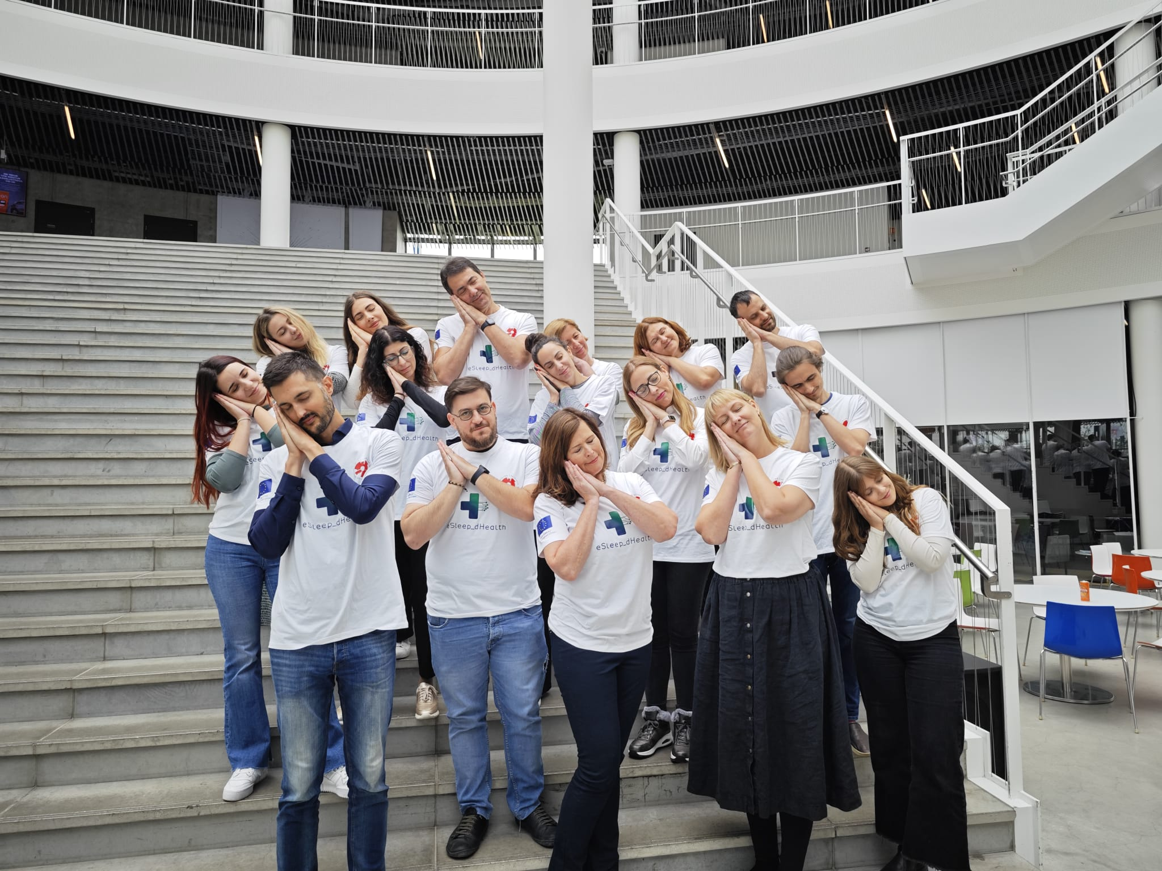

esleepdhealth.nethub.hr

